Slide 1


Ford Romania
2014 Masters Internship Program

Slide 2
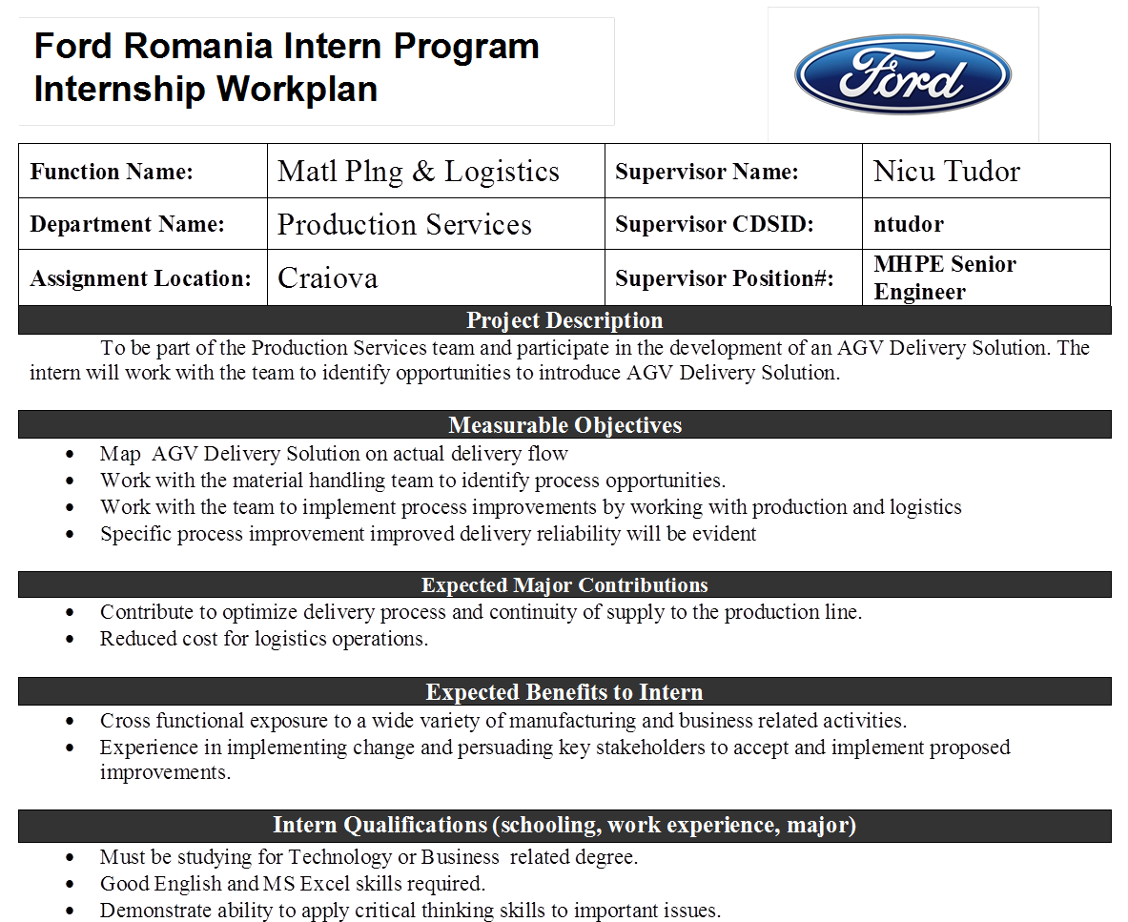

Slide 3
